Slide 1
Principles and techniques of reproducible science

Slide 2
Pre-test

Slide 3
Course Motivation
Trend towards LARGER and OPEN datasets in science
Desire to learn R
Data management & data provenance
Ability to synthesize data
What analysis do I do and why?
Designing experiments

Slide 4
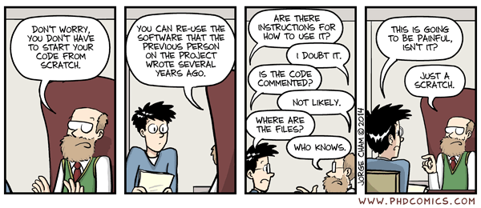
Course Motivation

Slide 5
Course learning outcomes
1. Students will understand the fundamentals of the reproducibility and accessibility in science
2. Students will apply the use of computer languages to solve challenges in reproducibility and accessibility in science
3. Students will create reproducible workflows for their own data

Slide 6
Plan for achieving course goals
Two main modules
Reproducibility crisis in science, data management, and responsible conduct in research
Computational tools for reproducibility and accessibility in data analysis

Slide 7
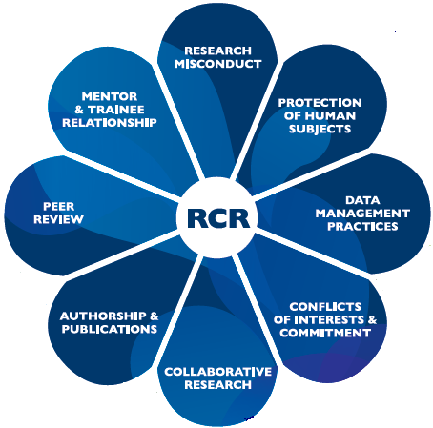
Reproducibility crisis, data management and RCR
Scientific professionalism, authorship etc.
Data management
Organizing yourself, file naming, file trees
https://www.research.nhg.com.sg/wps/wcm/connect/romp/nhgromp/06+conducting+research/rcr+core+components

Slide 8


Computational tools
Intro to R and Git
Intro to R markdown
ggplot and accessible and publishable figures
data handling – the tidyverse
writing functions
iterations and data simulation
Reproducible workflows

Slide 9
Reproducible
moral responsibility as a researcher
If a different research team (or yourself) can obtain its input data, its computational tools, understand them, and rerun the same methods to obtain the same result
If you were to look back at your own work in two years, could you understand it, do it again, and get the same results?
If you are giving a presentation or making recommendations, you best be sure the results are real
Or when reviews for a paper come back.
Can you find the data?
do you know what you did to it to get the results you got?
What if the reviewers question your computational workflow?
what if they ask for additional controls?
No silver bullet – best practices and everyone’s process is slightly different
You will have to find what works for you and easily communicate that for others

Slide 10
Replicability
A different research team can start with the same concept, and perhaps overlapping information, but regenerate their own data and methods that ultimately produce the same result.

Slide 11
files, where they are stored, how they are stored, what types of files. How they are managed
Reproducibility of data
vs.
reproducibility of analysis
programs, code, and workflows

Slide 12
Controls
Positive control: result expected
Negative control: null results
Every good experiment has both
Examples?
Why not in computational workflows?
If you randomize data is the p-value significant?

Slide 13
Computational Controls
Positive control for genome assembly – how do you know your genome is well assembled?
Known whole genome: can you computationally cut it up and reassemble it?
Simulations
Human genomes should not contain plant genes: chloroplast
A soil microbiome dataset should not match up with a marine microbiome

Slide 14
Controls
Electronic reproducibility: activities a computer can do for you
storing and documenting data in a repository
Management of version control
Protocol reproducibility: activities you do for yourself
naming schemes for files
consistency
annotation

Slide 15
Examples of real-life journals that have reproducibility standards
Nature journals have a checklist linking figures to data, statistics to methodology, and data to accessible repositories and originating specimens and assays
“It is Scientific Data's policy that all datasets central to a Data Descriptor manuscript; including computational or curated data, as well as data produced by an experimental or observational procedure – should be submitted to an appropriate external repository. We believe this is the best means of making these data discoverable, reproducible and reusable, and we work with our authors to identify the most appropriate location(s) for their data.”
“…Authors may submit supplementary information files – including code (also see our code availability policy), models, workflows and summary tables – however we strongly encourage deposition in repositories as a first preference, especially for primary data, which should not be submitted as supplementary information.”
https://www.nature.com/sdata/policies/data-policies#:~:text=All%20Springer%20Nature%20journals%2C%20including,Crossref%20and%20are%20openly%20available.

Slide 16
USDA guidelines
2016 – Chief Scientist charged the USDA Science Advisory Council to produce guidelines for reproducibility in agricultural and nutritional sciences
Challenges agricultural research faces
Data dredging – p-hacking. Searching for a significant result.
Omitting null results – negative results are still results
Under Powered studies – ensuring that the data collected identify actual differences other than by chance
Errors – Technical errors – hard to control
Under specified methods – Less detailed methods purposefully throw people off.
Weak experimental design
Weak Design execution – resources are not use properly, or inadequate supervision

Slide 17
USDA guidelines
2016 – Chief Scientist charged the USDA Science Advisory Council to produce guidelines for reproducibility in agricultural and nutritional sciences
Proposed changes
OPEN DATA – Public access to data and metadata including null results
Collaboration – cooperative data sharing agreements and scientific societies to open up dialog to enable cross discipline collaborations
Automation – data collection, handling, and record keeping
Open methods – Facilitating method sharing though scientific societies and publishers
Post publication – moving toward electronic rather than hard-copy publications can help with supplemental information sharing
Reporting guidelines – monitoring and supervising research through annual or quarterly reports

Slide 18
Big Data!!!
What the heck does that mean?

Slide 19


Bioinformatics

Slide 20
Big Data!!! and data provenance
Massive amounts of data
Data that is scattered all over the place
Data with heavy computation processes
Data that you can not easily go into an excel file and change….
Always know where your data came from and what was done to it.
Data Management Plans

Slide 21
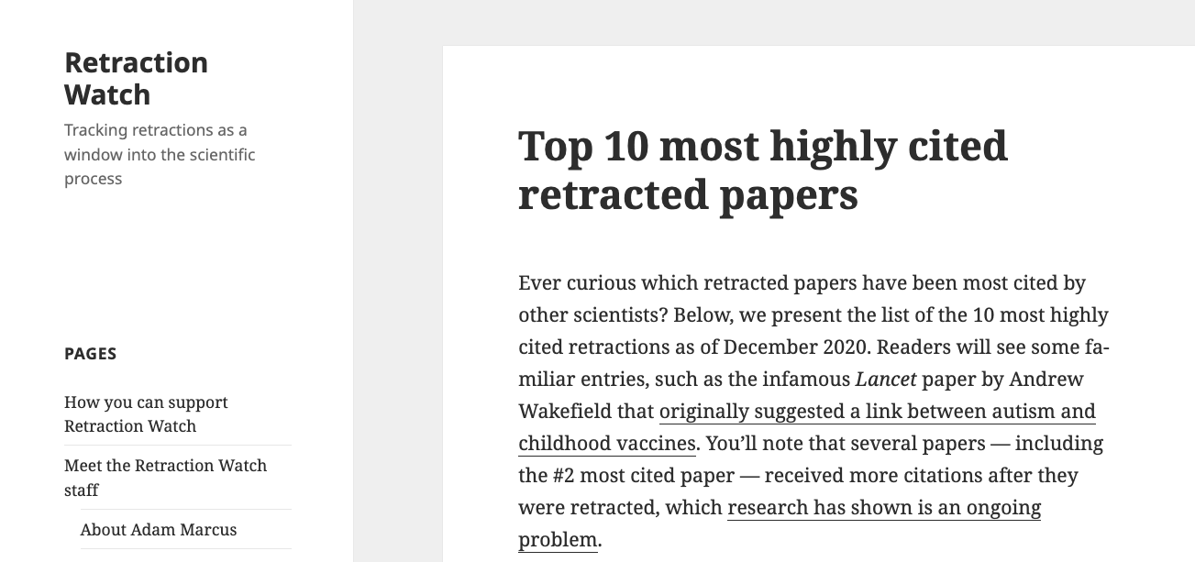

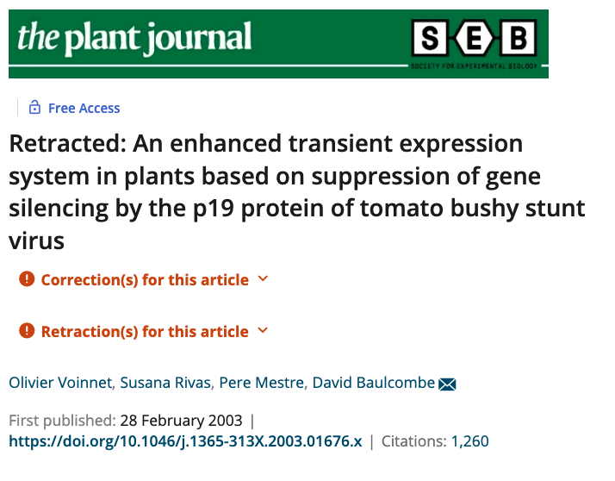
Scientific professionalism & responsible conduct in research
Intellectual integrity & honesty
Collegiality and openness
Public distrust of scientists & science
https://en.wikipedia.org/wiki/Mad_scientist

Slide 22
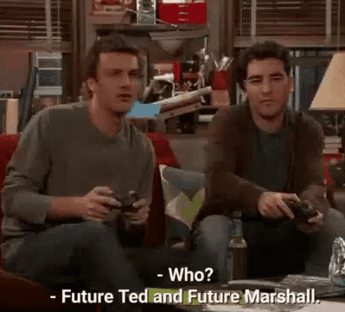
Organizing yourself for your future self & others
Naming files
Naming variables
README files
Organizing files into file trees

Slide 23


Tools for replication and accessibility & reproducible workflows
github
Deep dive into basic R syntax,
ggplot, R markdown, other advanced topics

Slide 24
FAIR Data management and analysis
Findable
Accessible
Interpretable
Reusable

Slide 25
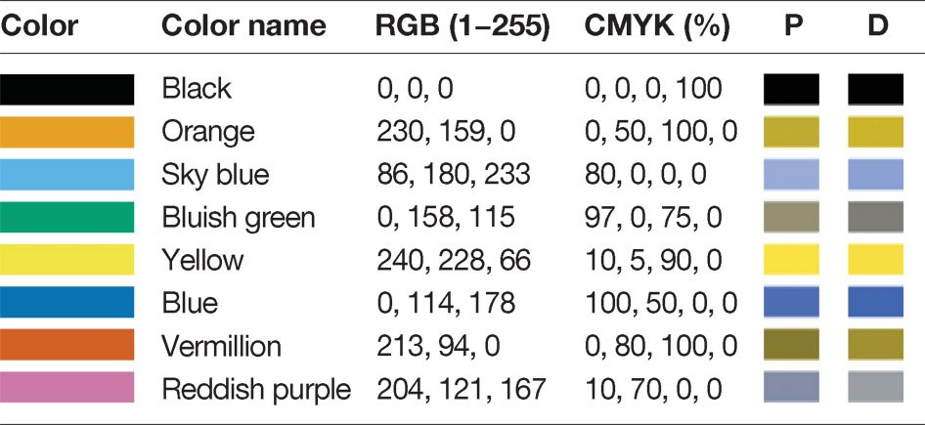
Figure generation, accessibility, and presentation of data
Appropriate use of color
Wong, B. Points of view: Color blindness. Nat Methods 8, 441 (2011). https://doi.org/10.1038/nmeth.1618

Slide 26
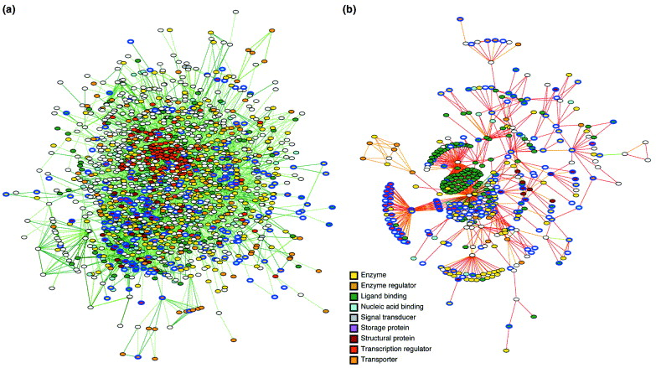
Figure generation, accessibility, and presentation of data
https://doi.org/10.1016/j.tibtech.2003.11.010

Slide 27
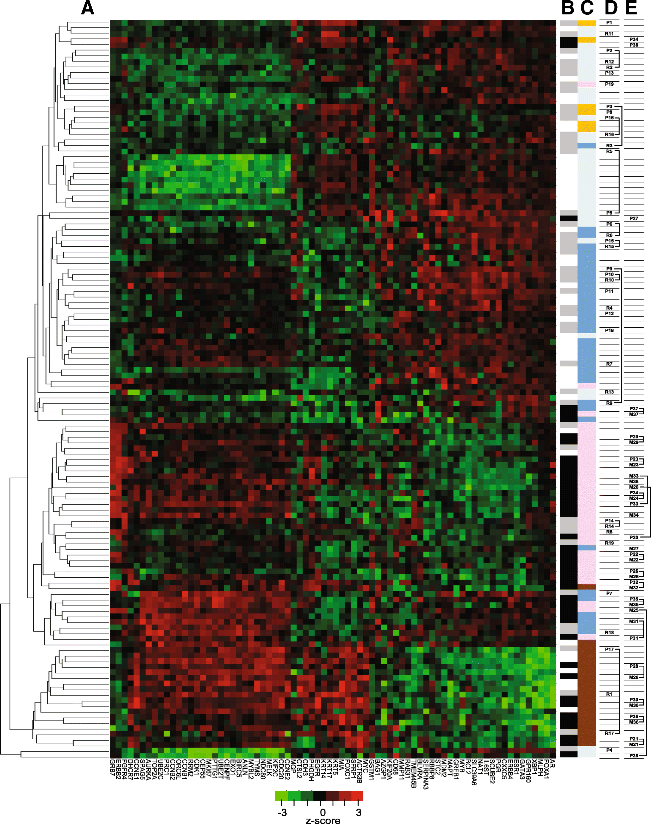
Figure generation, accessibility, and presentation of data
https://doi.org/10.1186/s12885-019-5752-8

